Slide 1

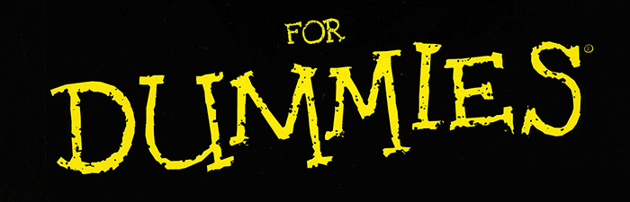

Take a seat!
We’ll start at 6:35pm <3
DATA
Intro to Python + Data
Intro to Machine Learning

Slide 2
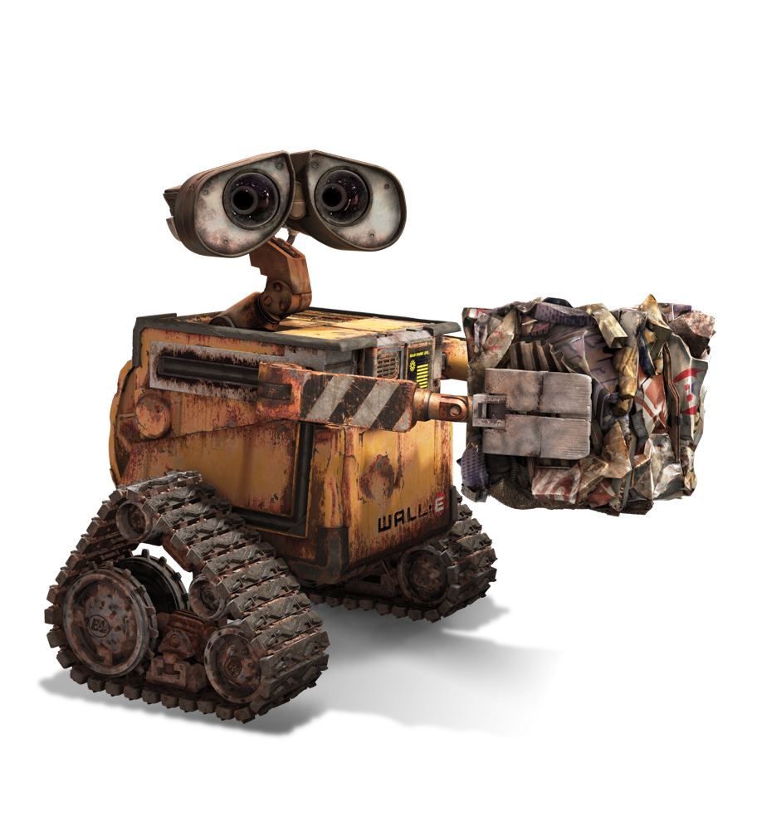
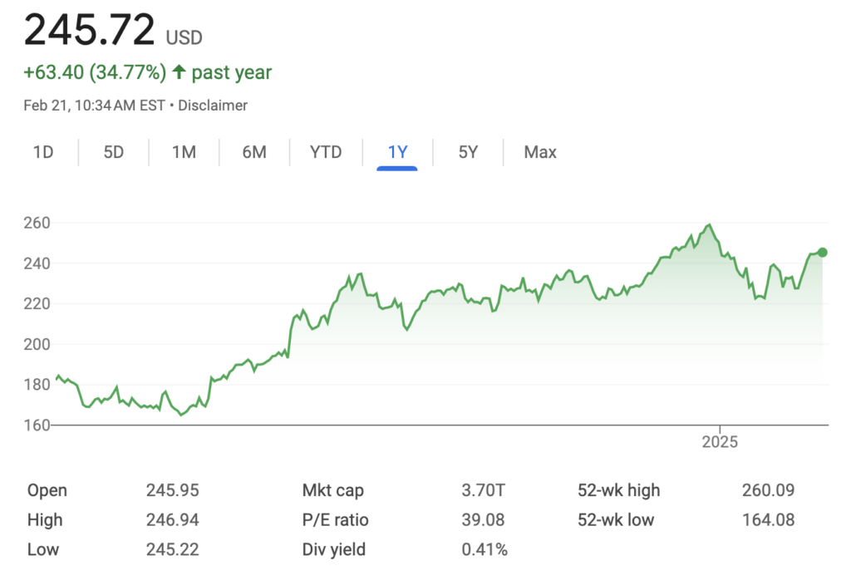
What is Machine Learning?
Machine Learning (ML) is the process of training a model to predict something
Examples:
Predicting the price of a house
Predicting if a credit card transaction is fraudulent
Predicting the future price of a stock

Slide 3
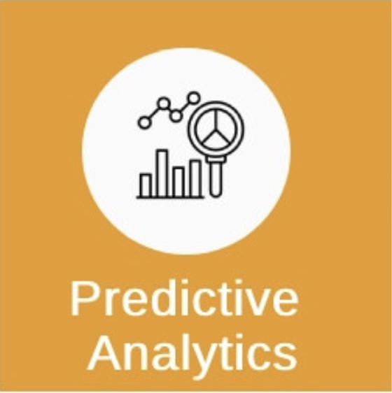

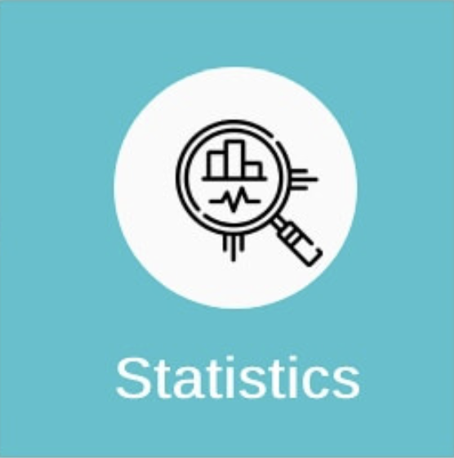
What is Machine Learning?
We can use our ML models to do two things:
Predictive Modeling: predicting something
Statistical Analysis: understanding the relationships between things
Example
Just trying to predict the price of your house
VS.
Finding what things affect the price of your house (size, location, etc.)

Slide 4
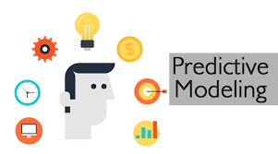
What is Machine Learning?
We can use our ML models to do two things:
Predictive Modeling: predicting something
Statistical Analysis: understanding the relationships between things
Both of these are important and usually intertwined (but not always!)
For these workshops, we will simply focus on predictive modeling

Slide 5
How do Machines Learn?
Models learn patterns in previous data and use that knowledge for prediction
Example
Suppose we want to predict house prices
We would show a model a bunch of house prices AND information about the houses
The model learns how different things affect house prices, and uses that for prediction

Slide 6
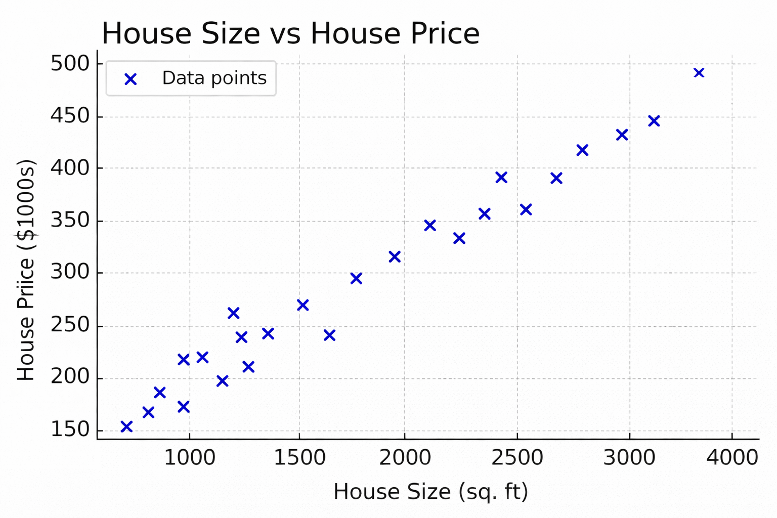
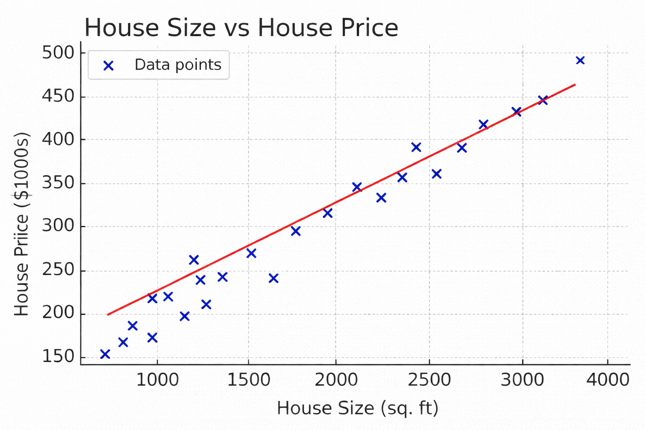
How do Machines Learn?
Models learn patterns in previous data and use that knowledge for prediction
Start w/ previous data
Learn patterns
Use patterns to predict
Here, our “model” is simply the line of best fit
We use it to predict, for example, that if a house is 3000 sq. ft, its price will be ~$450,000

Slide 7
The ML Workflow
Identifying the Problem
Ensure Proper Data Quality
Model Training and Testing
Model Evaluation
Model Fitting

Slide 8
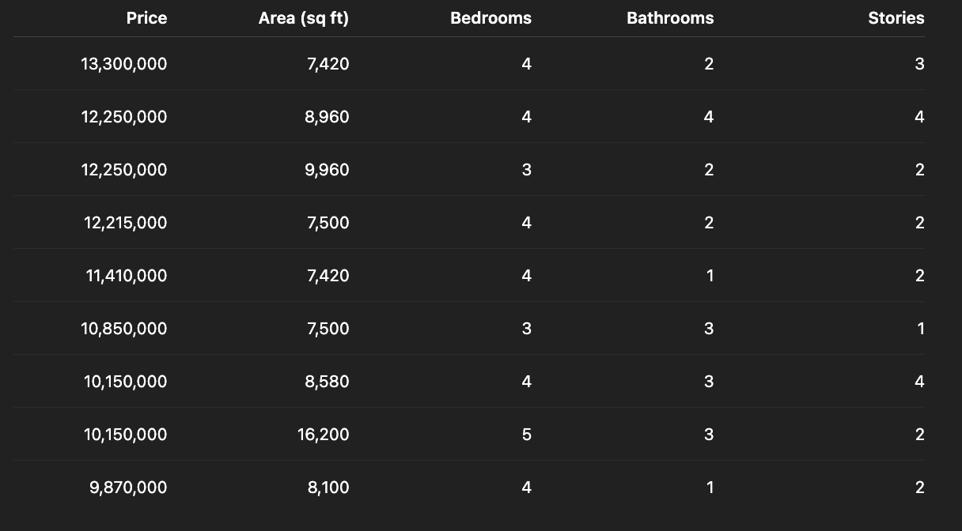
Identifying the Problem
Suppose we have the following data about some houses
Goal: use this data to predict the prices of new houses

Slide 9
Identifying the Problem
We must identify the following before starting:
Independent variables (called “X variables” or “features”)
Dependent variable (called the “Y variable” or “response”)

Slide 10
Identifying the Problem
Easy way to identify independent/dependent variables:
For most projects, your dependent variable is what you are trying to predict, everything else is independent

Slide 11
Identifying the Problem
Y
X’s
Easy way to identify independent/dependent variables:
For most projects, your dependent variable is what you are trying to predict, everything else is independent

Slide 12
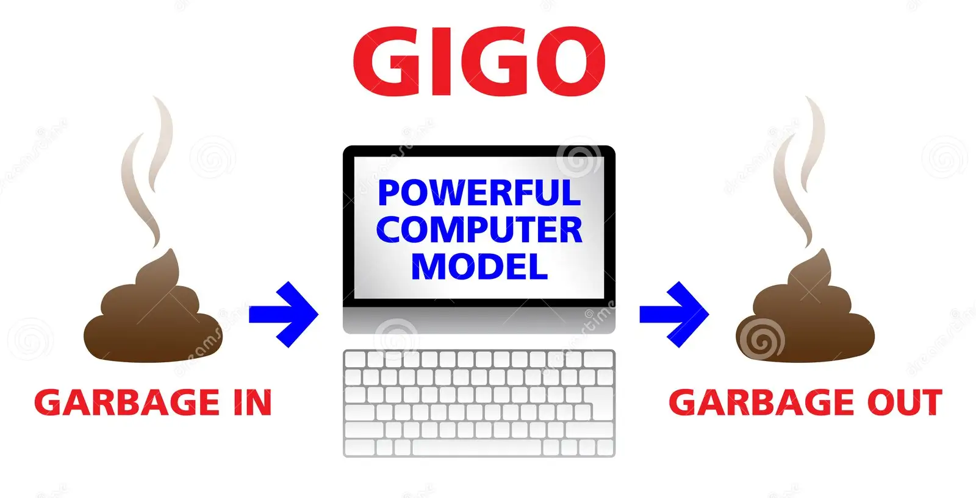
Data Cleaning & Preprocessing
Refer to Data Cleaning Workshop:
http://bit.ly/45HCoYu
Our data should be cleaned before we train our model to learn patterns from it!

Slide 13
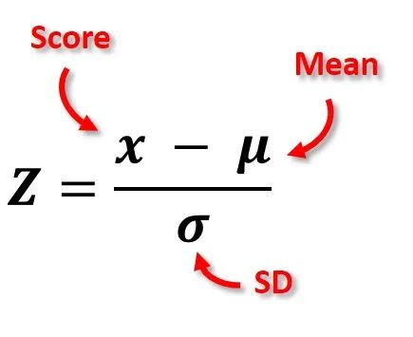
Data Cleaning & Preprocessing
Data Normalization: for non-tree models, you should normalize all numerical independent variables
This puts all variables onto the same scale which increases model performance during learning
For those of you who have taken PSTAT 120A/B!

Slide 14
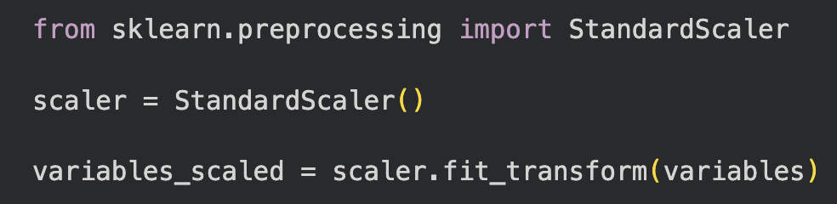
Data Cleaning & Preprocessing
Data Normalization: for non-tree models, you should normalize all numerical independent variables
We will go over more nuances with the code, but this is the general structure

Slide 15
Training & Testing Split
During the ML workflow, we will split up our data into two sets:
Training Set: the data that our model will study and learn patterns from
Testing Set: a “practice exam” which lets us see how accurate our model is

Slide 16
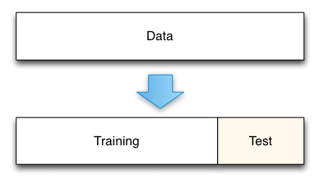
Training & Testing Split
How do we do this?
We just take our original dataset and randomly assign 80% of the rows to be in the training set, and the rest to be the testing set
100%
80%
20%

Slide 17
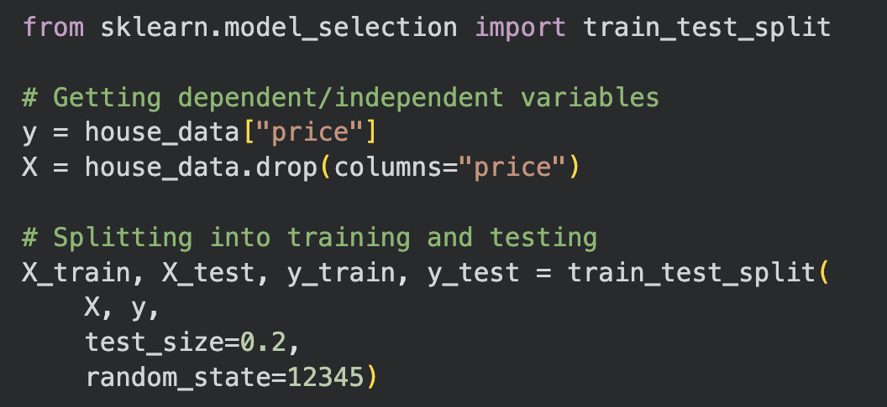
Training & Testing Split
How do we do this?
We just take our original dataset and randomly assign 80% of the rows to be in the training set, and the rest to be the testing set

Slide 18
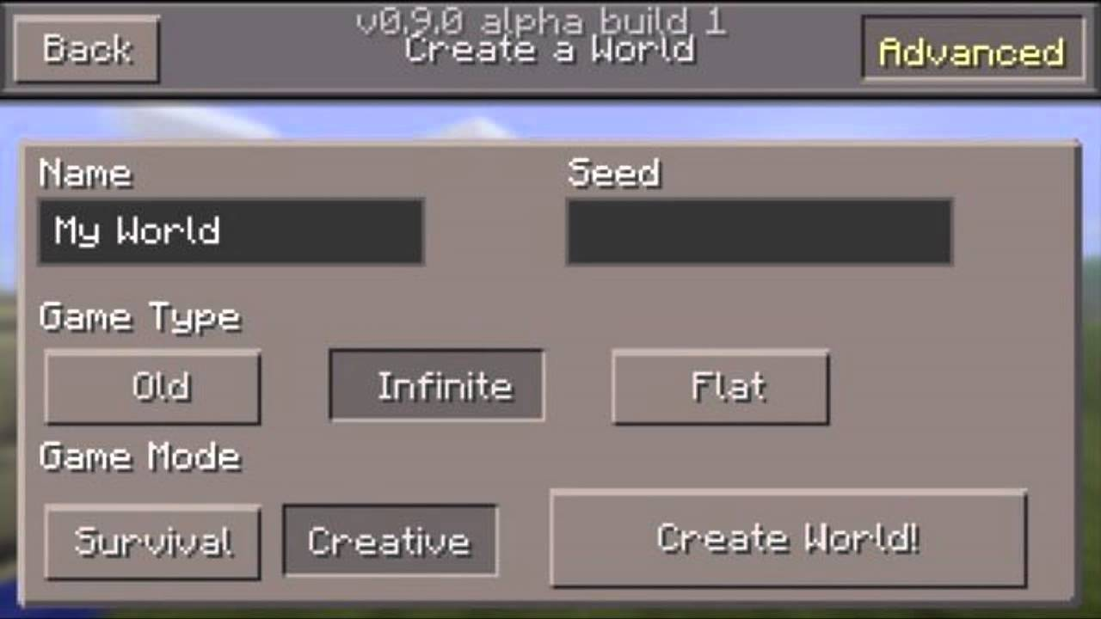
Training & Testing Split
Exactly like a random state!
Remember, “price” is our dependent (Y) variable in this problem, and everything else is independent variables (X)
Random state: essentially allows to save our random splits

Slide 19
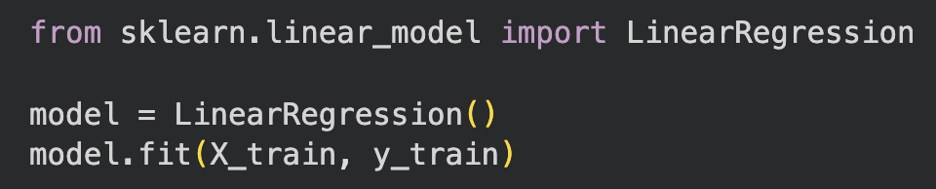
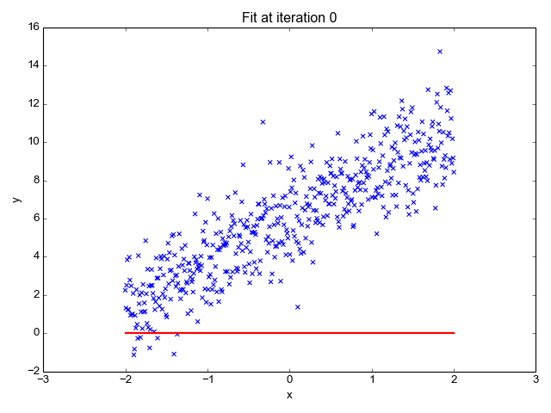
Model Fitting
Getting a model to learn patterns from the training set does not take much coding
Ex. Running a Linear Regression (line-of-best-fit) model on our house data
Creates the line of best fit!

Slide 20
Model Fitting
Getting a model to learn patterns from the training set does not take much coding
Ex. Running a Linear Regression (line-of-best-fit) model on our house data
IMPORTANT: the difficult part is choosing the best model for our problem, which we will go over next workshop

Slide 21
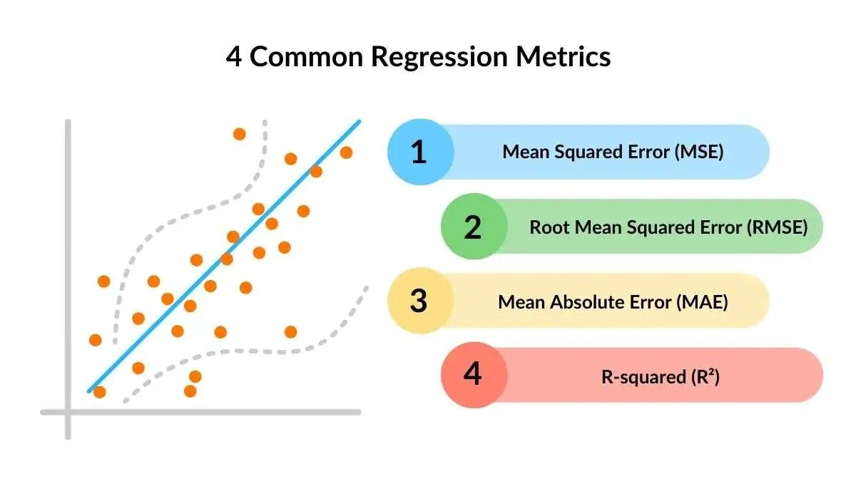
Model Evaluation
Finally, we need to evaluate how good our model is, we do this by:
Running our model on the training set (think of it like a practice exam)
Choose a performance metric (Accuracy, MSE, etc.) and use it to estimate how good the model is

Slide 22

Model Evaluation
Finally, we need to evaluate how good our model is, we do this by:
Running our model on the training set (think of it like a practice exam)
In our example, our line-of-best-fit model is predicting house prices based on our dependent variables such as: house size, # of bedrooms, etc.

Slide 23
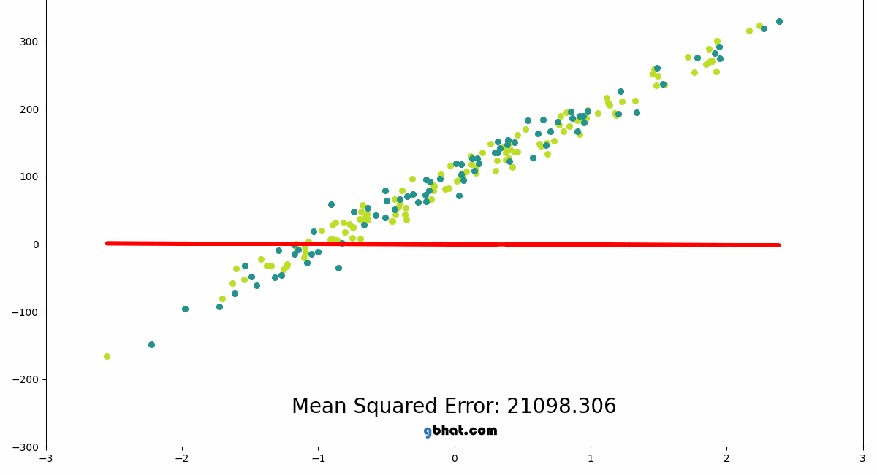
Model Evaluation
Finally, we need to evaluate how good our model is, we do this by:
Choose a performance metric (Accuracy, MSE, etc.) and use it to estimate how good the model is
Performance Metric: gives us a number showing how close the model’s predictions are to the correct values
For different problems and different models, you need to choose performance metric that are appropriate for the model/problem

Slide 24
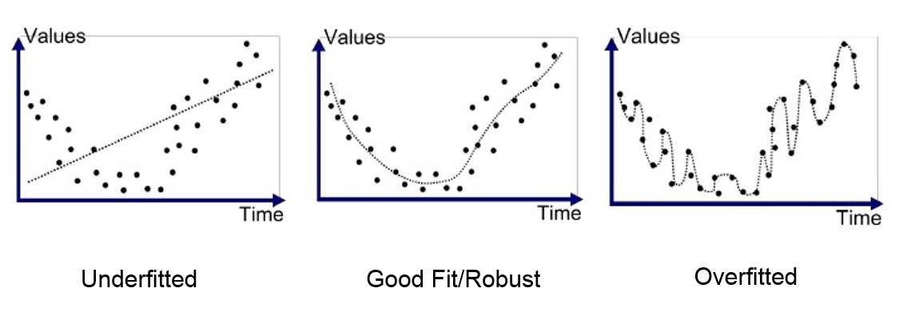
Rinse and Repeat!
In ML, you should always try out multiple models and look for ways to improve existing models. There are three main things to consider:
Underfitting: when a model performs poorly on training and testing sets
This means the model failed to learn any patterns during training

Slide 25
Rinse and Repeat!
In ML, you should always try out multiple models and look for ways to improve existing models. There are three main things to consider:
Underfitting: when a model performs poorly on training and testing sets
Overfitting: when a model performs well on training set, but poorly on testing set
This means the model learned the patterns of the training data TOO well

Slide 26
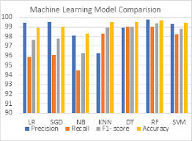
Rinse and Repeat!
In ML, you should always try out multiple models and look for ways to improve existing models. There are three main things to consider:
Underfitting: when a model performs poorly on training and testing sets
Overfitting: when a model performs well on training set, but poorly on testing set
Model Comparison: comparing two or more fitted models using performance metrics

Slide 27
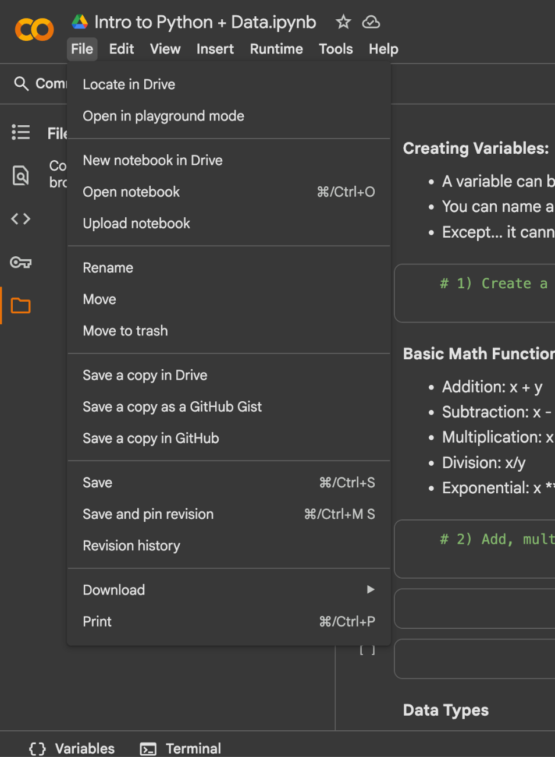
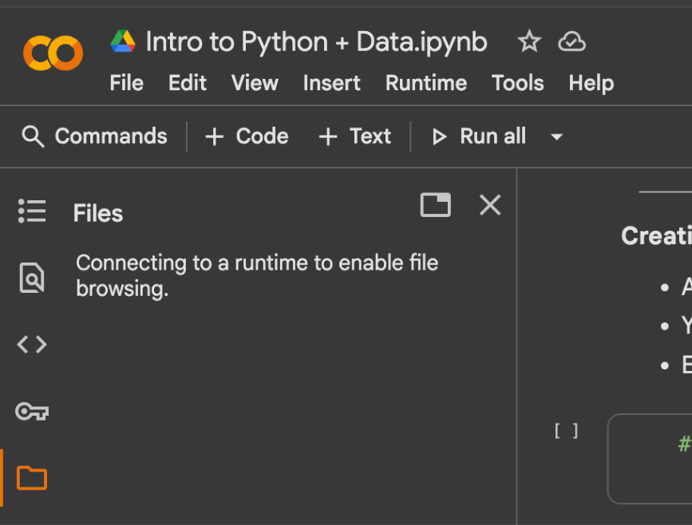
Your Turn!
Worksheet: https://bit.ly/4bKPjNc

