Slide 1



Take a seat!
We’ll start at 6:35pm <3
DATA
Intro to Python + Data
Intro to ML Algorithms

Slide 2
Review: ML Workflow
Identifying the Problem
Data Cleaning & Preprocessing
Training/Testing Split
Model Fitting
Model Evaluation
Rinse and Repeat

Slide 3
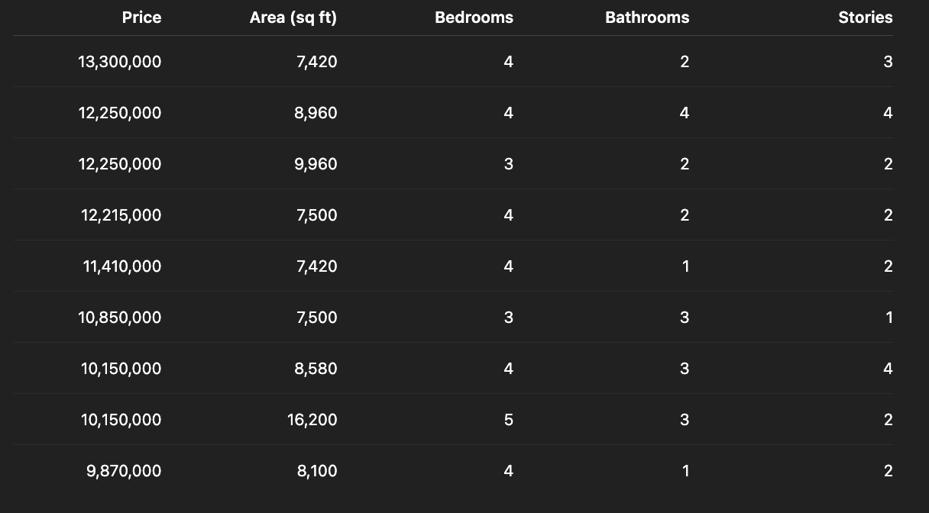
Review: ML Workflow
Identifying the Problem
Y
X’s
Always start by identifying your response and feature variables

Slide 4
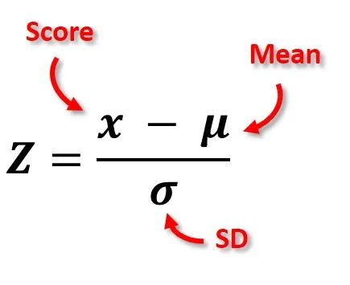
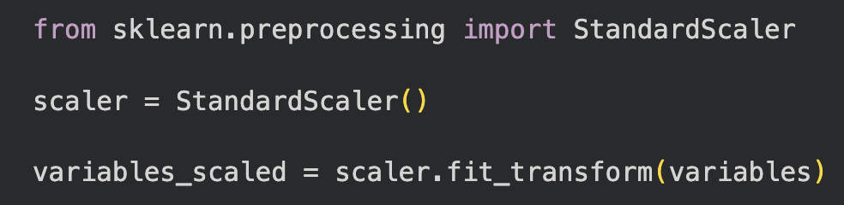
Review: ML Workflow
Data Cleaning & Preprocessing
We need to ensure that our data is cleaned and that our numerical features are normalized
Data Cleaning Workshop: http://bit.ly/45HCoYu
How to normalize variables:
Do NOT normalize when using tree-based models (you will understand this by the end of today)

Slide 5
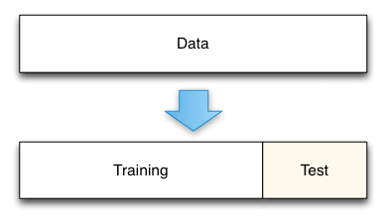
Review: ML Workflow
Training/Testing Split
Training Set: the data that our model will study and learn patterns from
Testing Set: a “practice exam” which lets us see how accurate our model is
We split by simply assigning 80% of the rows in our data to be “training” and the other 20% as “testing”
100%
80%
20%

Slide 6
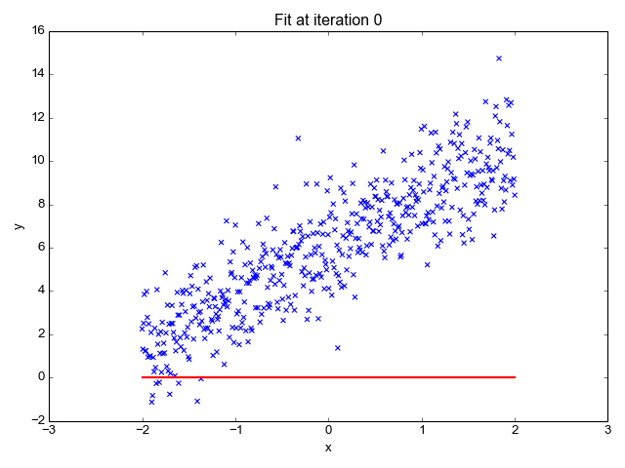
Review: ML Workflow
Model Fitting
This is where our model learns patterns from the training data
Ex. Running a Linear Regression (line-of-best-fit) model on some data
Today we will learn about different models and how to select the appropriate one!

Slide 7
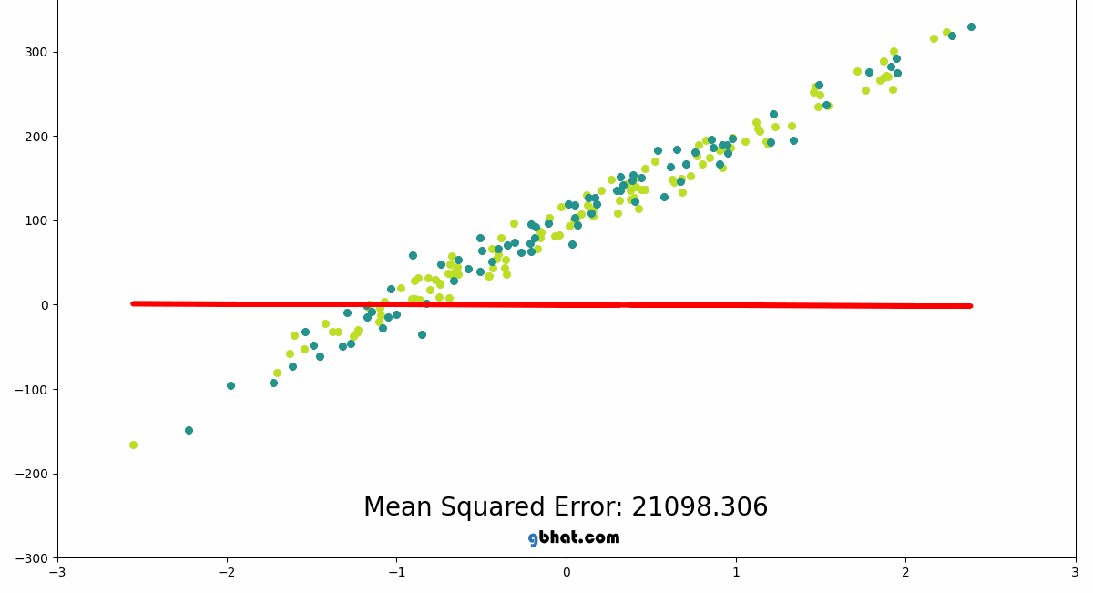
Review: ML Workflow
Model Evaluation
To see how good our model did, we let our model practice on the testing set then grade it using a performance metric
Here, we can see how the MSE gets better as the line-of-best-fit gets better
Today, we will learn about different performance metrics (such as MSE) and when to use each

Slide 8
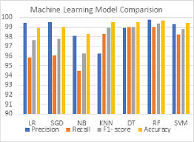
Review: ML Workflow
Rinse and Repeat
For any given problem, we should always try different models and make improvements on each
We can use the performance metrics from Step 5 to compare two models

Slide 9
Review: ML Workflow
Rinse and Repeat
For each model, we should also look for these common issues:
Underfitting: Poor performance on both training and testing sets
The model did not learn any patterns
Overfitting: Good performance on training set but bad performance on testing set
The model learned the patterns of the training set TOO well

Slide 10
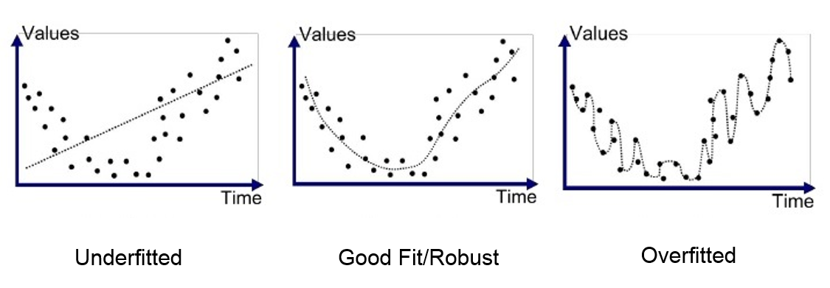
Review: ML Workflow
Rinse and Repeat
For each model, we should also look for these common issues:
Underfitting: Poor performance on both training and testing sets
Overfitting: Good performance on training set but bad performance on testing set

Slide 11
Identifying the Problem
ML Task
Supervised Learning
Unsupervised Learning
Regression
Classification
Our job is to look at our ML task and determine what kind of problem it is and approach it accordingly

Slide 12
Identifying the Problem
ML Task
Supervised Learning
Unsupervised Learning
How can we tell the difference?
Regression
Classification
Our job is to look at our ML task and determine what kind of problem it is and approach it accordingly

Slide 13
Supervised vs. Unsupervised Learning
Supervised Learning: predicting something given previous data about it
We already covered these in the ML workflow!
How to think about it: for each observation we are given the corresponding response value for it
Ex. When predicting house prices, we knew the price of each house in our dataset
The model uses these known values when learning patterns for prediction

Slide 14
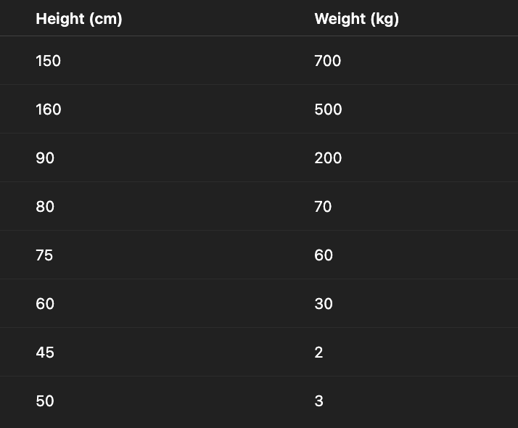
Supervised vs. Unsupervised Learning
Unsupervised Learning: finding patterns in data where we are not given a particular response value
These problems do not go through the standard ML workflow we covered
Ex. Suppose we are given the following data for some unlabelled farm animals and want to look for patterns between the animals

Slide 15
Supervised vs. Unsupervised Learning
Ex. Suppose we are given the following data for some unlabelled farm animals
Here, we may want to know what animal each of these observations are even though we can’t see
An unsupervised model might help us find patterns like:
Short + Heavy = Pig
Short + Light = Chicken
Tall + Heavy = Cow

Slide 16
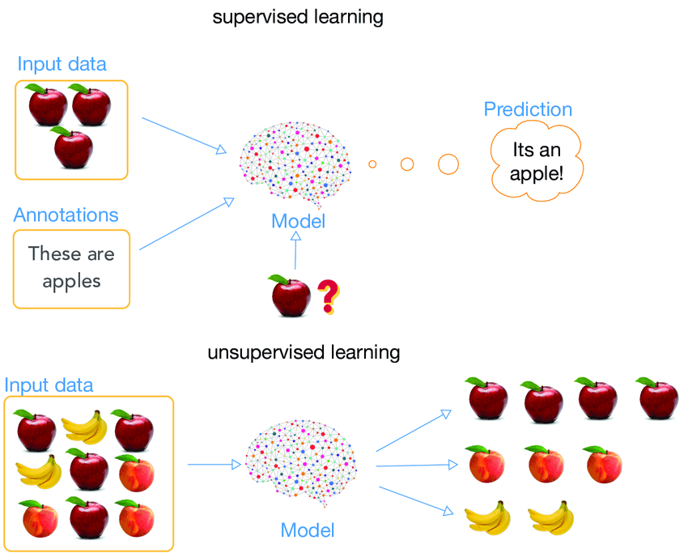
Supervised vs. Unsupervised Learning
So, how can we tell if our task is supervised or unsupervised?
We want to predict the value of something Supervised
We want to find an unknown pattern in data Unsupervised

Slide 17
Identifying the Problem
ML Task
Supervised Learning
Unsupervised Learning
Regression
Classification
Our job is to look at our ML task and determine what kind of problem it is and approach it accordingly

Slide 18
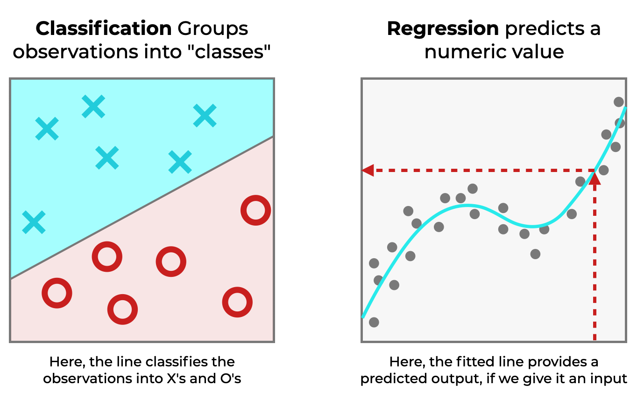
Regression vs. Classification
We know that for any supervised learning task, we are provided with a response variable
There are two kinds of supervised tasks based on the form of the response
Regression: the response is a continuous number
Classification: the response is categorical

Slide 19

Regression vs. Classification
In ML, we look to predict new values of our response variable
There are two types of ML problems based on the form of the response, it is our job to correctly assess which problem we are dealing with
Regression: the response is a continuous number
Examples:
House prices ($100000, $250000, …)
Exam Scores (75.8, 98.6, …)
Temperature (-5, 65, 90, …)

Slide 20

Regression vs. Classification
In ML, we look to predict new values of our response variable
There are two types of ML problems based on the form of the response, it is our job to correctly assess which problem we are dealing with
Regression: the response is a continuous number
Classification: the response is categorical
Examples:
Disease vs. Healthy
Pass vs. Fail

Slide 21
Regression vs. Classification
We need to know if our task is regression or classification since models are typically built to do one or the other
Let’s go over these models!

Slide 22
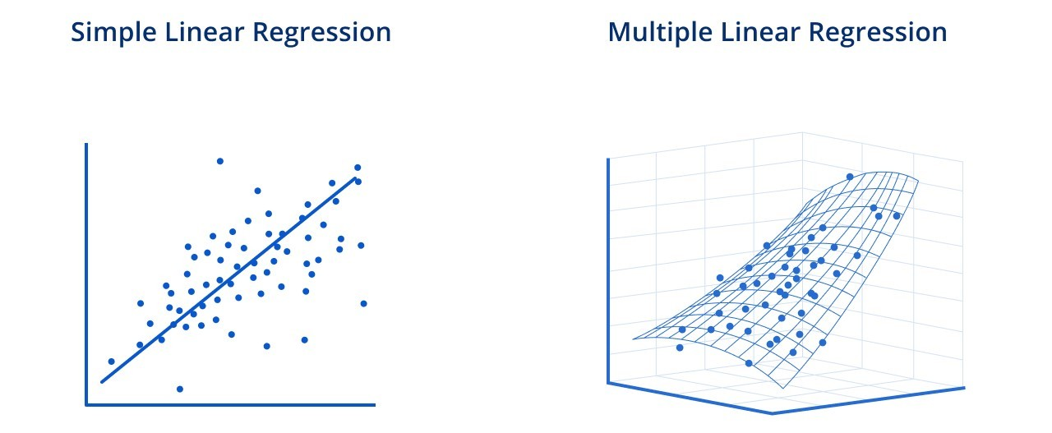


Linear Regression
Linear Regression: simplest regression model that is built off the idea of the “line-of-best-fit”
The computer does its math magic to find optimal values for β and ε in the equation form

Slide 23
Linear Regression
Linear Regression: simplest regression model that is built off the idea of the “line-of-best-fit”
The computer does its math magic to find optimal values for β and ε in the equation form

Slide 24
Linear Regression
What are some things we can do to improve a linear regression model?
Feature Selection
Not all feature variables are useful for our model!
Ex. Imagine if we included a variable like “Owner’s favorite soda” to our house price prediction model
We would want to REMOVE this variable as it may negatively impact our model’s training process

Slide 25
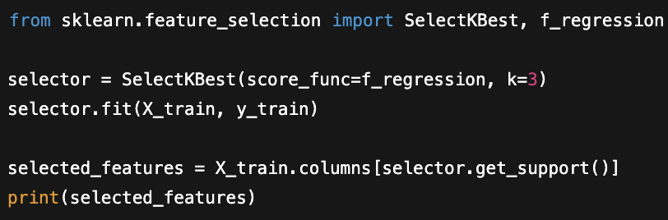
Linear Regression
What are some things we can do to improve a linear regression model?
Feature Selection
We can use the functions below to only keep features that have statistically significant effects on the response variable

Slide 26
Linear Regression
What are some things we can do to improve a linear regression model?
Feature Selection
We can use the functions below to only keep features that have statistically significant effects on the response variable
This value k is a “hyperparameter”, we might try different values to get different results
Hyperparameter: something we choose before model training which affects how the model learns

Slide 27
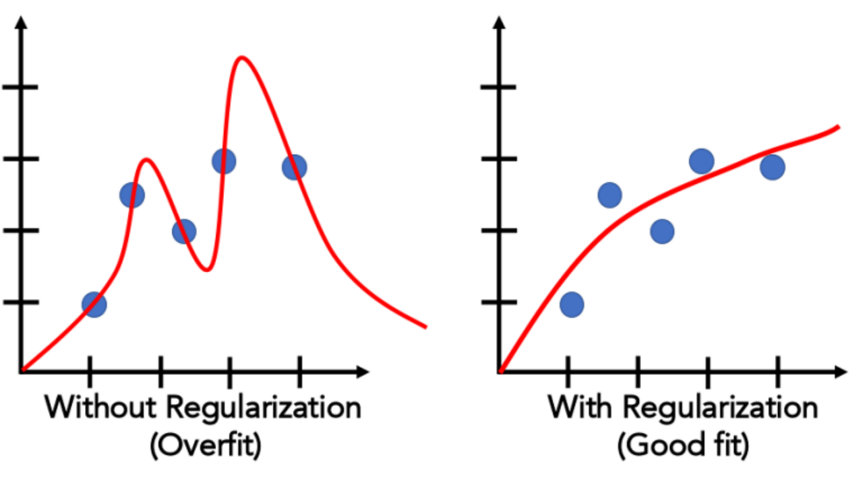
Linear Regression
What are some things we can do to improve a linear regression model?
Lasso and Ridge (Regularization)
These are extensions of Linear Regression that reduce the importance of certain feature variables
These should be used if the standard Linear Regression model is overfitting

Slide 28
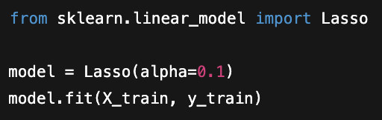
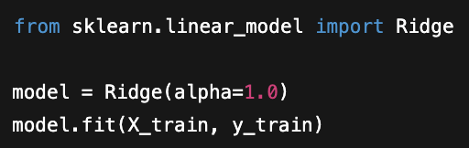
Linear Regression
What are some things we can do to improve a linear regression model?
Lasso and Ridge (Regularization)
Hyperparameter that controls how “strong” the importance reduction is
How our choice of alpha impacts the model:
Too small: reduction is too weak and overfitting problem is not solved
Too large: model does not learn well and starts to underfit

Slide 29
Linear Regression
What are some things we can do to improve a linear regression model?
Lasso and Ridge (Regularization)
Hyperparameter that controls how “strong” the importance reduction is
It is best to just try different values and compare the models you make using performance metrics
NOTE: Lasso is naturally stronger than Ridge

Slide 30
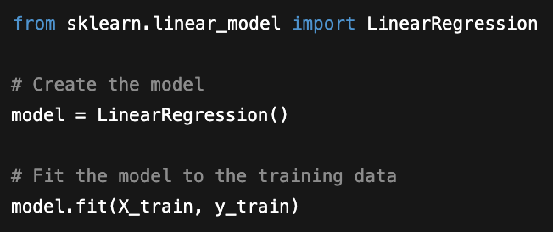
Linear Regression
Linear Regression fitting code:

Slide 31
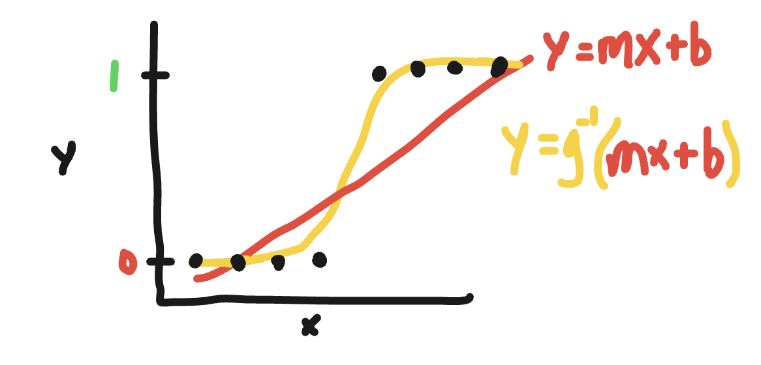
Logistic Regression
Logistic Regression: despite its name is the simplest classification model which is a modification of linear regression
This algorithm essentially creates a linear regression, then applies a function to force the output to be categorical

Slide 32
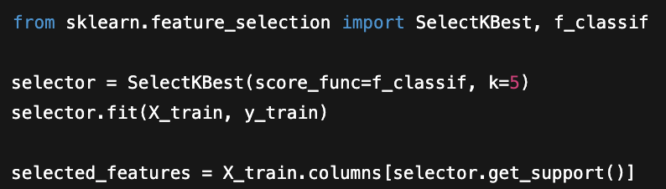
Logistic Regression
What are some things we can do to improve a Logistic Regression model?
Feature Selection
Code is slightly different than from Linear Regression

Slide 33
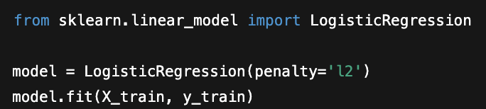
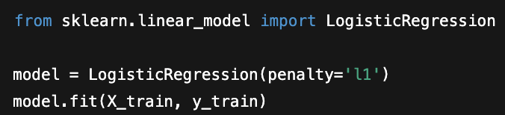
Logistic Regression
What are some things we can do to improve a Logistic Regression model?
Lasso and Ridge (Regularization)
Code is slightly different than from Linear Regression
Note that you will commonly see
Lasso called L1 Regularization
Ridge called L2 Regularization

Slide 34
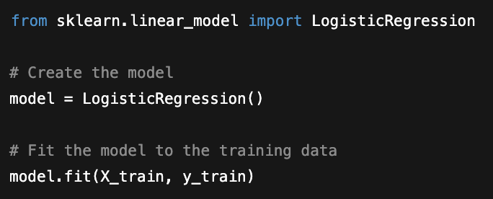
Logistic Regression
Logistic Regression fitting code:

Slide 35
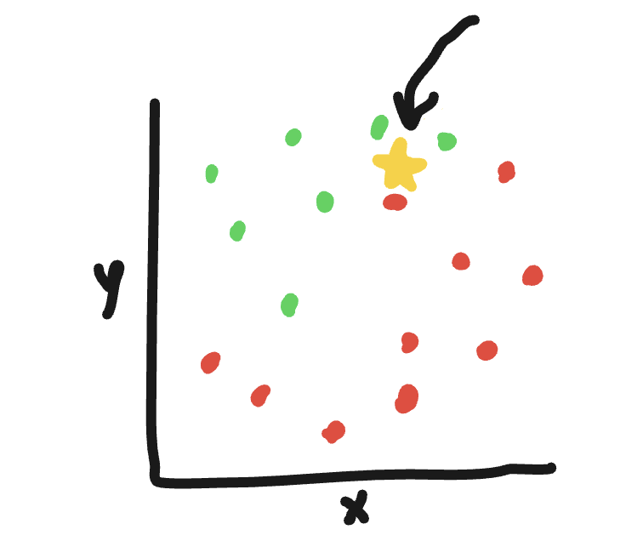
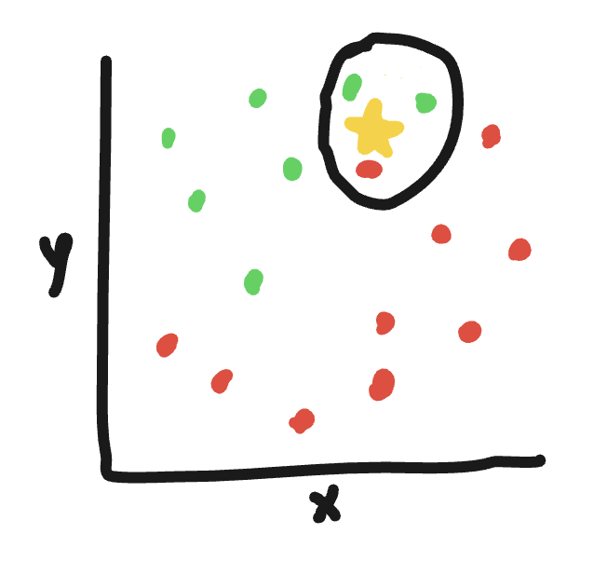
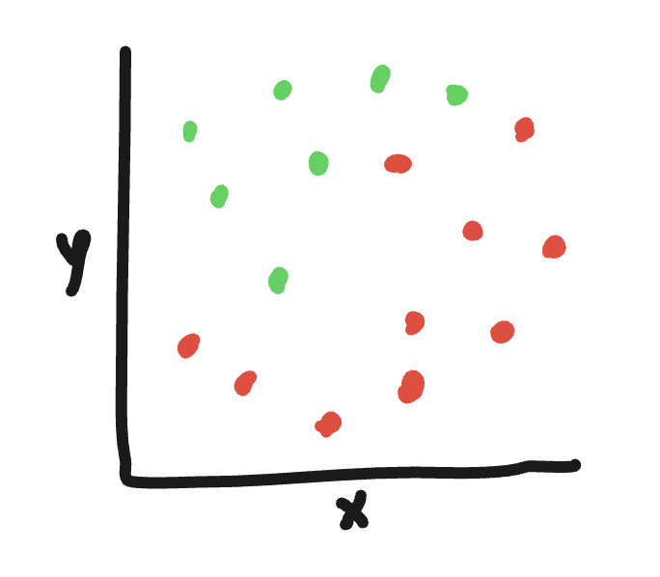
K-Nearest Neighbors (KNN)
K-Nearest Neighbors: algorithm that can be used for both regression and classification tasks
KNN Classifier:
new point!
Plot all our previous data
2) Plot the point we want to predict
3) Examine the points nearest to our new point

Slide 36
K-Nearest Neighbors (KNN)
K-Nearest Neighbors: algorithm that can be used for both regression and classification tasks
KNN Classifier:
Here, since most of the neighbors are green, the model will predict that the new point will be green

Slide 37
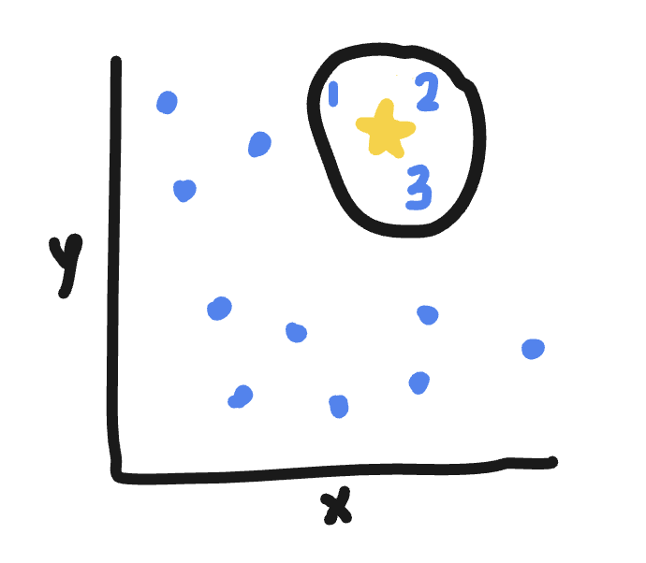
K-Nearest Neighbors (KNN)
K-Nearest Neighbors: algorithm that can be used for both regression and classification tasks
KNN Regressor: same as the classifier but uses averages instead of majority for prediction
Suppose the response values of the nearest neighbors are:
#1: 100
#2: 200
#3: 250
Here, we take the average and predict that the new point has a response value of ~183.33

Slide 38
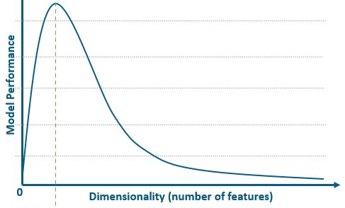
K-Nearest Neighbors (KNN)
There is one important drawback to KNN algorithms
Curse of Dimensionality: KNN model performances significantly decreases when used with 4 or more features
This means that when using this algorithm, we should have:
A small dataset (3 or less features)
OR
Performed feature selection to pick the best 3 or less

Slide 39
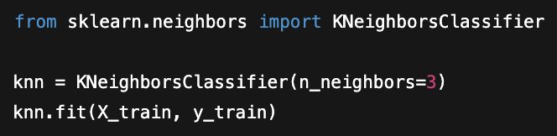
K-Nearest Neighbors (KNN)
How can we improve a KNN model?
Number of Neighbors Hyperparameter
Hyperparameter that changes how many neighbors we look at during prediction
How our choice of neighbors impacts the model:
Too little: risk of underfitting
Too many: risk of overfitting
If you fit a model and notice under/overfitting, just tweak the number of neighbors

Slide 40
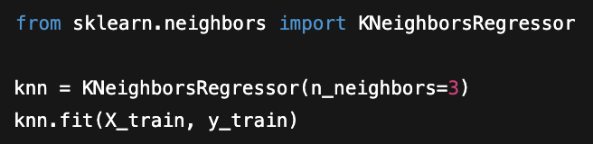
K-Nearest Neighbors (KNN)
KNN Classifier fitting code:
KNN Regressor fitting code:

Slide 41
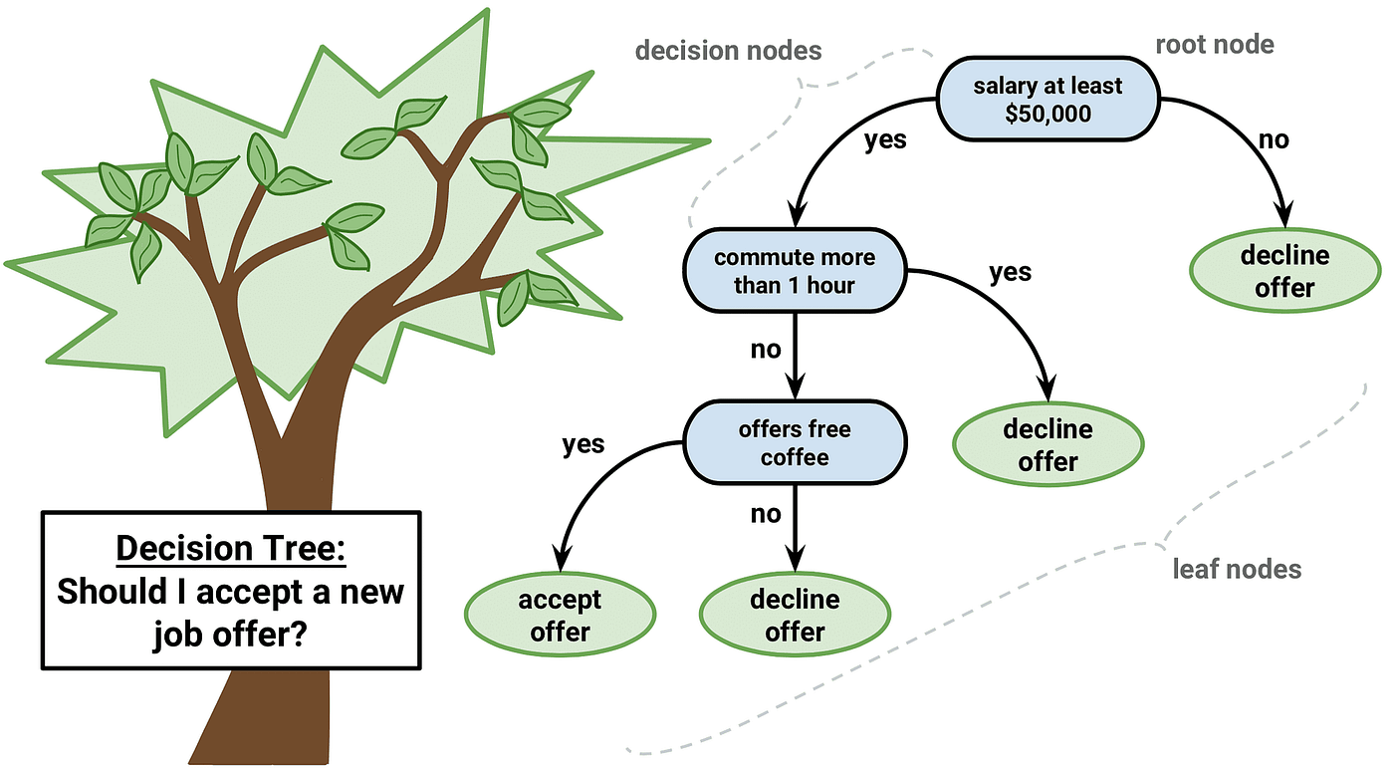
Decision Trees
Decision Tree: the simplest tree-based model which makes a prediction based on a set of decisions
Can be used on both regression and classification tasks
Very interpretable and easy to see what is going on!
The model does math magic to find the optimal value to split on at each variable

Slide 42

Decision Trees
Decision Tree: the simplest tree-based model which makes a prediction based on a set of decisions
This algorithm is extremely simple and not suitable for most tasks
Very prone to overfitting
However, this is the foundation of all tree-based models which can be extremely useful!

Slide 43
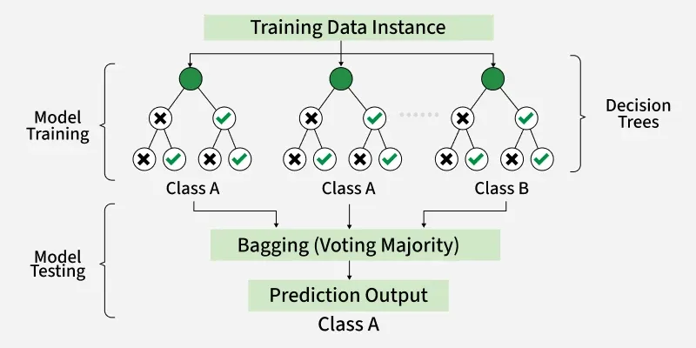
Random Forest
Random Forest: trains a bunch of Decision Trees and uses all the different results
RF Classification: predicts a new value to be the class of the majority result from all the trees

Slide 44
Random Forest
Random Forest: trains a bunch of Decision Trees and uses all the different results, can be used for both regression and classification
RF Regression: predicts a new value to be the average result of all the trees
Each tree would output a number instead of a class

Slide 45
Random Forest
Random Forest: trains a bunch of Decision Trees and uses all the different results, can be used for both regression and classification
Why does this work?
Each of the different trees is given a different set of the data and different features
This ensures that the model does not just “remember” the training data and reduces overfitting

Slide 46
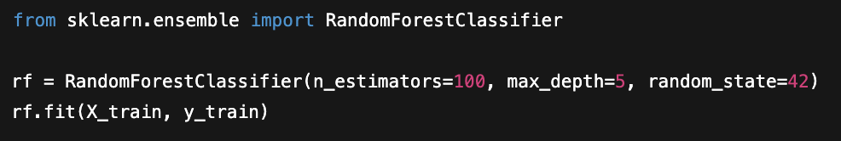
Random Forest
How can we improve a Random Forest Model?
Number of Trees Hyperparameter
Allows us to control how many trees will be made
How does this affect model performance?
Too little: risk of overfitting
Too many: no consequence on performance, but at some point adding more trees will not improve performance

Slide 47
Random Forest
How can we improve a Random Forest Model?
2) Maximum Depth Hyperparameter
Allows us to control the max amount of splits a tree can make
How does this affect model performance?
Too little: trees are too simple, risk of underfitting
Too many: risk of overfitting

Slide 48
Random Forest
How can we improve a Random Forest Model?
2) Maximum Depth Hyperparameter
In this example, this tree makes 3 splits

Slide 49
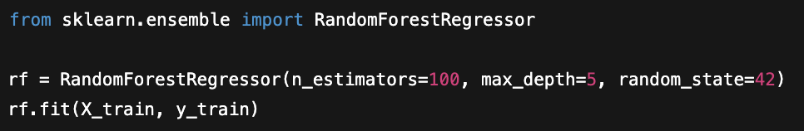
Random Forest
Random Forest Classifier fitting code:
Random Forest Regressor fitting code:

Slide 50
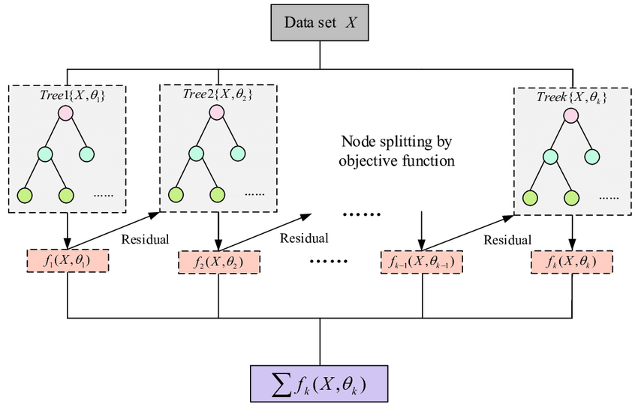
XGBoost
XGBoost: a tree-based model that trains Decision Trees iteratively, can be used for both regression and classification
This means that Decision Trees are trained one at a time, with each one improving on the previous tree’s mistakes
On the contrary, Random Forest just trains all the Decision Trees at once (neither affects one another)

Slide 51
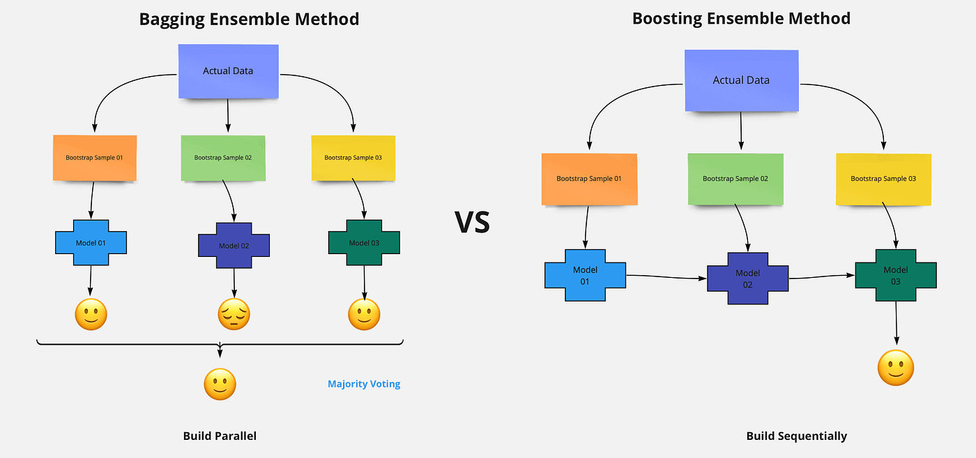
XGBoost
XGBoost: a tree-based model that trains Decision Trees iteratively, can be used for both regression and classification
Due to this more complex training, XGBoost is known for:
Having higher performance capacities than Random Forests
Being able to handle more complex tasks
BUT takes a long time to train and is prone to overfitting

Slide 52
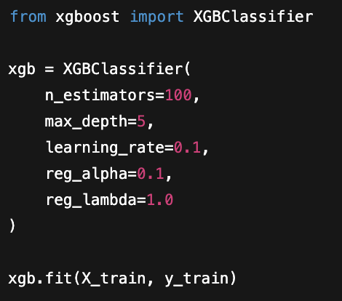
XGBoost
How can we improve an XGBoost model?
# of Trees + Maximum Depth Hyperparameters
Same things we saw in Random Forest

Slide 53
XGBoost
How can we improve an XGBoost model?
Learning Rate Hyperparameter
How does this affect performance?
Too slow: model never gets to the optimal solution
Too fast: model overshoots optimal solution, risk of overfitting
Controls how much the trees build off each other at each step

Slide 54
XGBoost
How can we improve an XGBoost model?
Lasso and Ridge (Regularization
Same things we saw in previous models

Slide 55
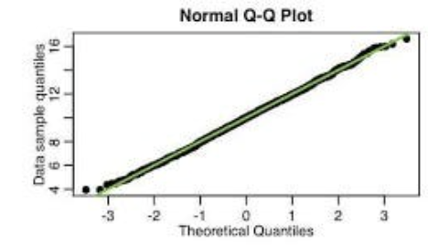
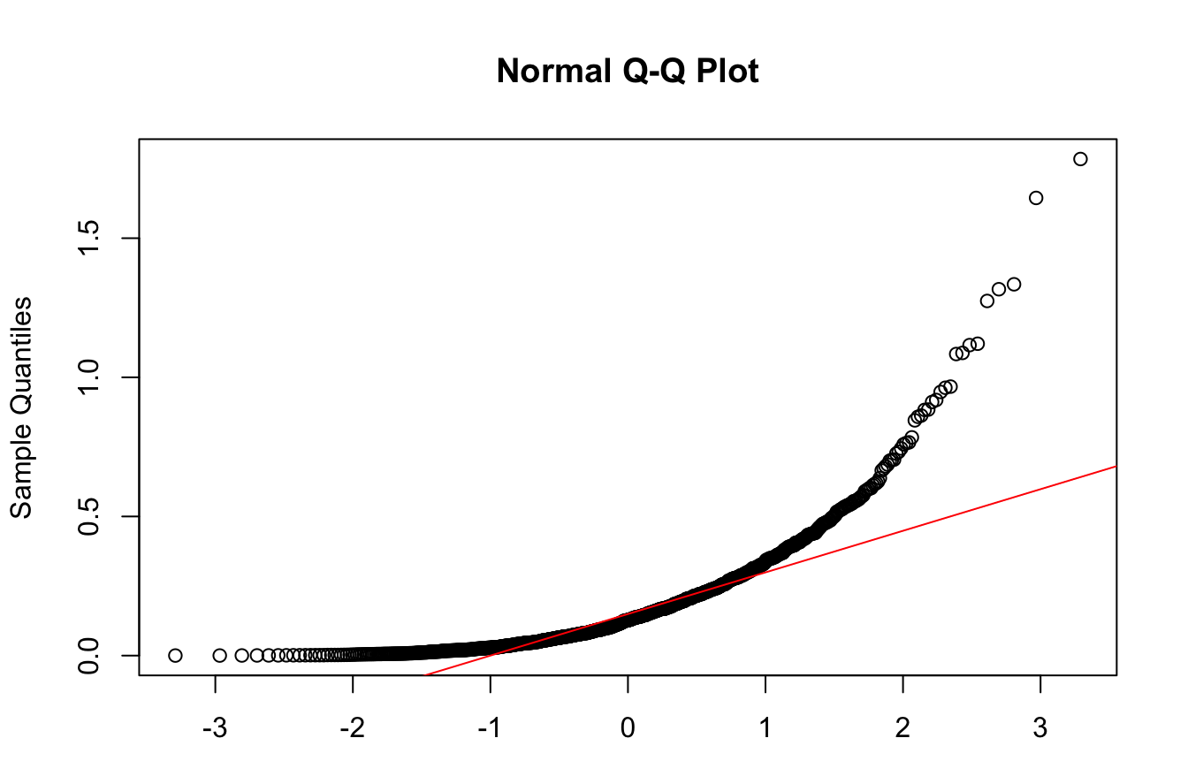


Linear Regression
Quick overview: Assumptions of Linear Regression
Normality: the response has to be Normally distributed
How to check: use a Q-Q Plot, the points should generally be a straight line

Slide 56
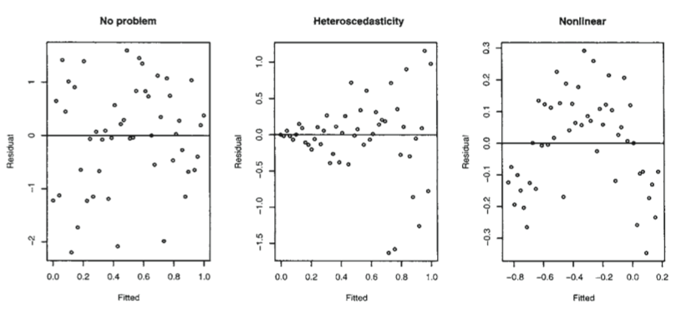
Linear Regression
Quick overview: Assumptions of Linear Regression
2) Linearity: there must be a linear relationship between the response and feature variables
How to check: use Fitted vs. Residuals Plot, points should be randomly scattered on the graph (no funnels or curves)

Slide 57
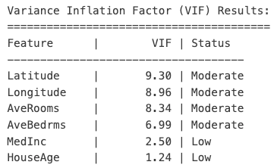
Linear Regression
Quick overview: Assumptions of Linear Regression
3) Multicollinearity: feature variables should not be correlated to each other
How to check: find VIF of each feature, if it is >5 then it should be removed

